Slide 1
BUSINESS MANAGEMENT AND STRATEGY
{ACHIEVING AN ORGANIZATION’S OBJECTIVES}

Slide 2
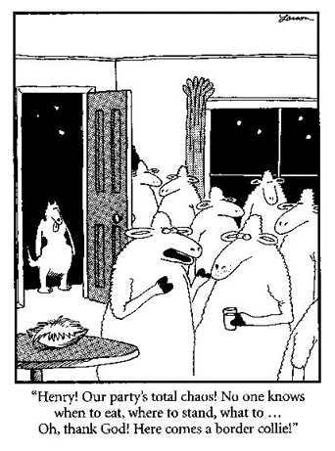
BUSINESS MANAGEMENT

Slide 3

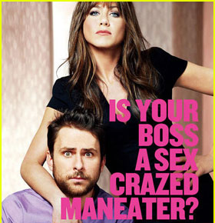
HORRIBLE BOSSES

Slide 4
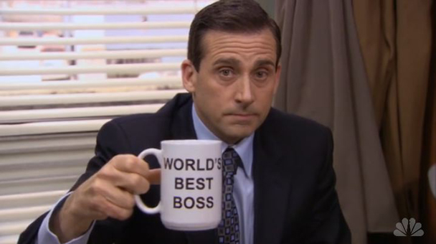
INSPIRING EMPLOYEES THE MICHAEL SCOTT WAY

Slide 5




TRADITIONAL MANAGERIAL FUNCTIONS
Management
  The process of planning, organizing, leading, and controlling a firm’s financial, physical, human, and information resources to achieve its goals
Planning
Setting Goals
Controlling
Monitoring Performance
Organizing
Structuring
Leading
Guiding and Motivating

Slide 6

PLANNING
The Planning Process
  Determining firm’s goals
  Developing strategy for achieving goals
  Designing tactical and operational plans for implementing the strategy

Slide 7
A HIERARCHY OF PLANS
Strategic Plans
  Reflect decisions about resource allocations, company priorities, and the steps needed to meet strategic goals
Tactical Plans
  Shorter-term plans for implementing specific aspects of the company’s strategic plans
Operational Plans
  Mid-level and lower-level managers set short-term targets for daily, weekly, or monthly performance

Slide 8
ORGANIZING
The Organizing Process
  Arranging resources and activities in a coherent structure
  Helps create synergy
  Establishes lines of authority, improves communication, helps avoid duplication of resources, and can improve effectiveness by speeding up decision making

Slide 9
LEADING
Leading
  Guiding and motivating employees to meet the organization’s objectives
  Communicate vision and get others around that vision
  Establish corporate values and promote corporate ethics
  Embrace change
  Provide coaching and feedback on performance

Slide 10

CONTROLLING
The Controlling Process
  Monitoring a firm’s performance to make sure that it is meeting its goals

Slide 11
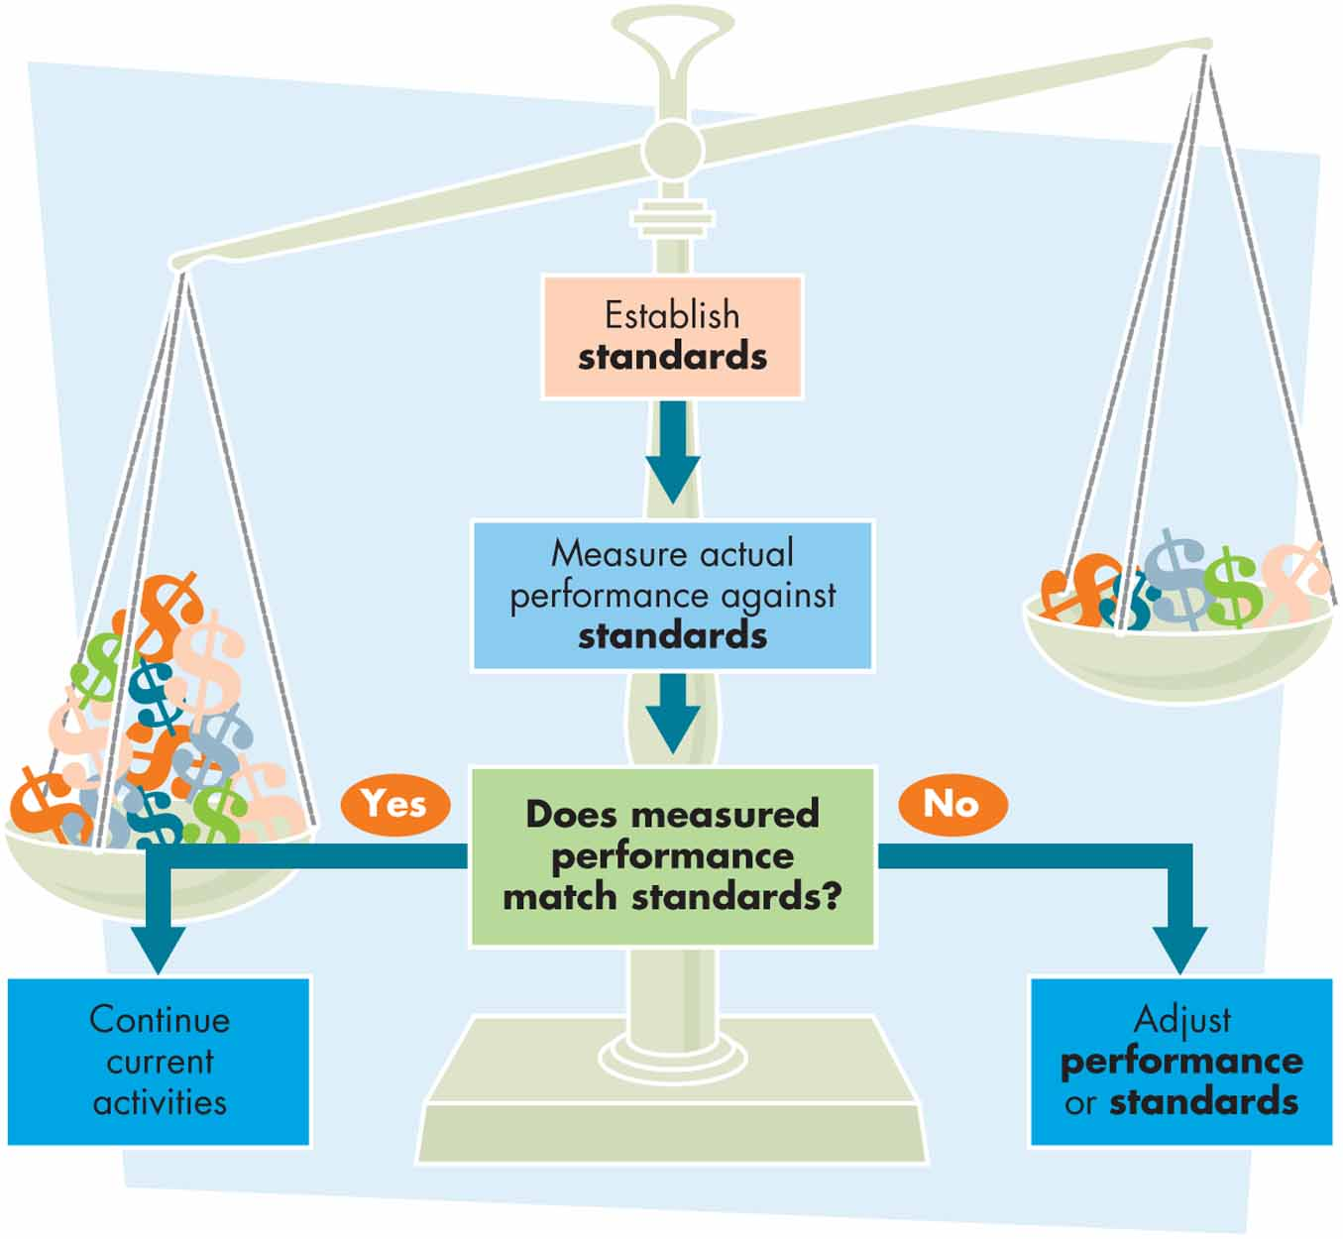
THE CONTROL PROCESS

Slide 12
UPDATED MANAGERIAL FUNCTIONS
Making Things Happen
Meeting the
Competition
Organizing People, Projects, & Processes
Leading
These new functions do not replace the classical functions of management; they build on them.

Slide 13



LEADERSHIP STYLES
Autocratic
Democratic
Free-Rein
Make decisions and then tell employees what must be done and how to do it
Works best when dealing with lower‑level employees who are poorly motivated and require more supervision to accomplish the task
Allow employees to get involved in decisions
Generally requires less employee supervision
Works best with highly skilled, trained, and motivated employees
Allow employees to work without much interference
Employees must know the standards and be motivated to attain them
Works best with highly skilled, trained, and motivated employees

Slide 14
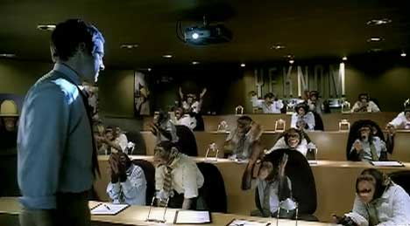
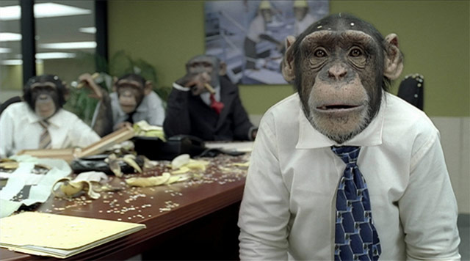
BOSS TRANSLATOR

Slide 15



LEVELS OF MANAGERS
Top managers
  President, vice president, treasurer, CEO, CFO
Middle managers
  Plant manager, operations manager, division manager, regional manager
First-line Managers
  Supervisor, office manager, department manager, project manager, team leader
Top
Management
Middle Management
Lower Management

Slide 16




TOP MANAGERS
Responsible for…
Creating a context for change
Developing attitudes of commitment
and ownership in employees
Creating a positive organizational
culture through language and action
Monitoring their business environments
Notes:
CHAPTER ONE

Slide 17




MIDDLE MANAGERS
Responsible for…
Setting objectives consistent with top
management goals, planning strategies
Coordinating and linking groups,
departments, and divisions
Monitoring and managing the performance
of subunits and managers who report to them
Implementing the changes or strategies
generated by top managers
Notes:
CHAPTER ONE

Slide 18



FIRST-LINE MANAGERS
Responsible for…
Managing the performance of
entry-level employees
Teaching entry-level employees
how to do their jobs
Making schedules and operating plans based on
middle management’s intermediate-range plans
Notes:
CHAPTER ONE

Slide 19



MANAGERIAL ROLES
Interpersonal
Roles
Informational
Roles
Decisional
Roles
Figurehead
Leader
Liaison
Monitor
Disseminator
Spokesperson
Entrepreneur
Disturbance
Handler
Resource
Allocator
Negotiator
Notes:
CHAPTER ONE

Slide 20
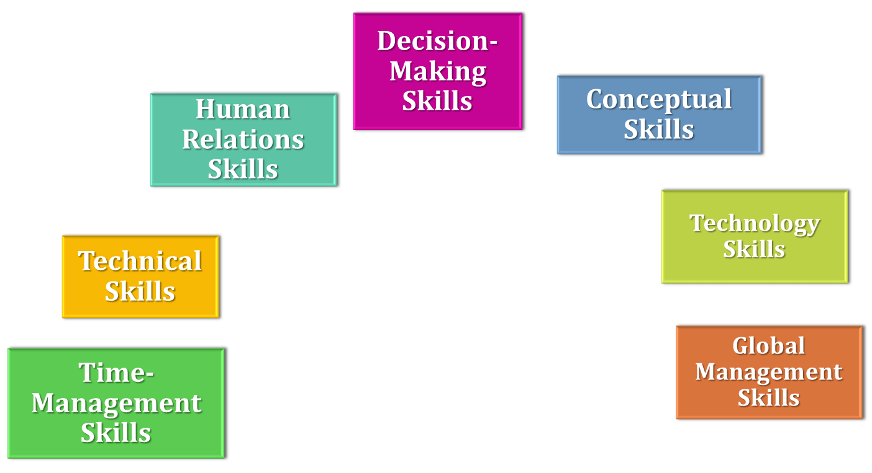

BASIC MANAGERIAL SKILLS

Slide 21
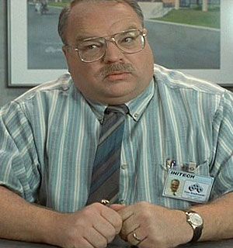
ENGINEERS ARE NOT GOOD AT DEALING WITH CUSTOMERS
“I have people skills. I am good at dealing with people! Can't you understand that?”
~ Tom Smykowski,
Office Space

Slide 22






A MODEL OF MANAGERIAL COMPETENCIES
Communication
Competency
Teamwork
Competency
Planning and Administration Competency
Managerial
Effectiveness
Global Awareness Competency
Strategic Action Competency
Self-Management Competency
Notes:
CHAPTER ONE

Slide 23
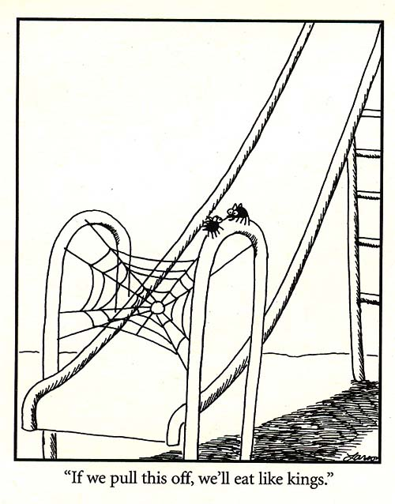
BUSINESS STRATEGY

Slide 24
SETTING GOALS & FORMULATING STRATEGY
Strategic Management
  The process of helping an organization maintain an effective alignment with its environment
Goals
  Starting point in effective strategic management
  Objectives that a business hopes and plans to achieve
Strategy
  The broad set of action plans to achieve company goals

Slide 25
SETTING BUSINESS GOALS
Goals
  Performance targets that organizations and their managers use to measure success or failure
Effective organizations set goals at many different levels:
  Long-term goals: five years or more
  Intermediate goals: one to five years
  Short-term goals: one year or less
Mission Statement
  A statement of how a business will achieve its fundamental purpose

Slide 26
PURPOSES OF GOAL SETTING
Goal Setting:
  – Provides direction and guidance for managers at all levels
  – Helps firms allocate resources
  – Helps to define corporate culture
  – Helps managers assess performance

Slide 27

TYPES OF STRATEGY
Corporate Strategy
  Determines what business or businesses a company will own and operate
  Growth
    Related diversification
    Unrelated diversification
  Retrenchment
    Downsizing and divestiture

Slide 28
TYPES OF STRATEGY (CONT.)
Business (or Competitive) Strategy
  Focuses on improving the company’s competitive position at the level of the business unit or
  product line
Functional Strategy
  Guides managers in specific areas in deciding how best to achieve corporate goals by performing their functional activities most effectively

Slide 29
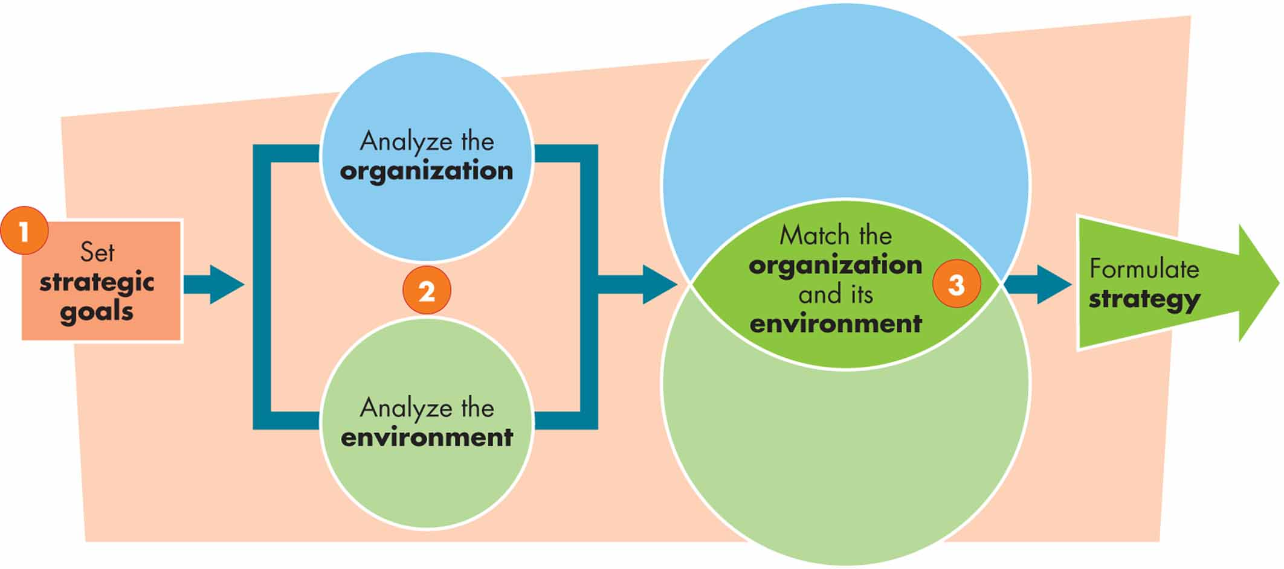
FORMULATING STRATEGY

Slide 30
FORMULATING STRATEGY
Step 1: Setting Strategic Goals
  Strategic goals are derived from a firm’s mission statement
Step 2: Analyzing the Organization and the Environment: SWOT Analysis
  Assessing internal strengths and weaknesses and external opportunities and threats
    Environmental analysis
    Organizational analysis
Step 3: Matching the Organization and Its Environment
  Matching environmental threats and opportunities against corporate strengths and weaknesses

Slide 31
SETTING GOALS
S.M.A.R.T.
    Specific
    Measurable
    Attainable
    Realistic
    Timely
Notes:
CHAPTER FOUR

Slide 32
SITUATIONAL ANALYSIS (SWOT)
S
Strengths
Internal
W
Weaknesses
O
Opportunities
External
T
Threats
Notes:
CHAPTER FOUR

Slide 33
MCDONALD’S SWOT
Strengths | Weaknesses
Strong brand value sustains the company’s leadership position Diversified geographic presence provides opportunity to gain from economic buoyancy in emerging markets Large scale of operation compared to peers | Legal proceedings affect brand image adversely Product failures such as Arch Deluxe
Opportunities | Threats
Growth franchisee operated restaurants Positive outlook for out-of-home eating market can boost top line in long run Growing hot drinks market: another favorable trend to drive topline | Rise in food prices Intense competition in retail food industry Growing consumer consciousness for healthy food products

Slide 34
SUSTAINABLE COMPETITIVE ADVANTAGE
Resources
The assets, capabilities, processes,
information, and knowledge that the
organization controls
Competitive
Advantage
Providing greater value for customers
than competitors can
Sustainable
Competitive
Advantage
A competitive advantage that other
companies have tried unsuccessfully
to duplicate
Notes:
CHAPTER FOUR

Slide 35
CONTINGENCY PLANNING AND CRISIS MANAGEMENT
Contingency Planning
  Planning for change
  Seeks to identify in advance important aspects of a business or its market that might change and the ways in which a company will respond to changes
Crisis Management
  Involves an organization’s methods for dealing with a crisis—an unexpected emergency requiring immediate response

Slide 36
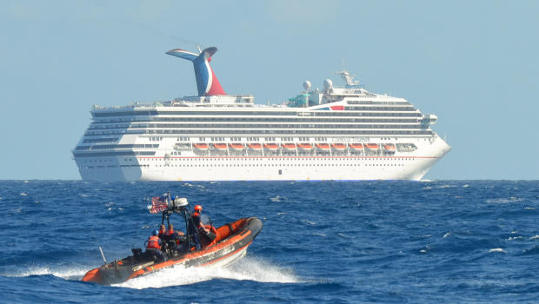
CONTINGENCY PLANNING AND CRISIS MANAGEMENT
Troubled Waters: The Carnival Triumph

Slide 37
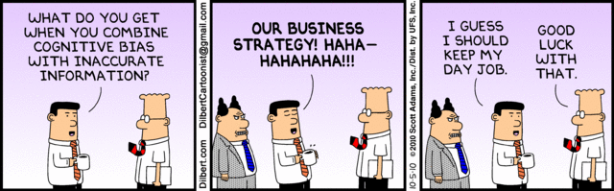
QUESTIONS OR CLARIFICATIONS?

